Slide 1
AYTOMATED FORENSIC ANALYSIS
2016 MSc Cyber Security Project Presentation
Anastasios Koutlis
MSc in Cyber Security
University of York
Supervisor
Prof. Howard Chivers
September
2016

Slide 2
Overview
Introduction
Existing Work
Literature Review
Design & Methodology
Implementation
Evaluation
Future Work & Conclusion
References

Slide 3
Introduction
Problem
Existence of a large number of artifacts in a computer that must be processed
Time consuming process
Danger of missing important connections
Idea
Provide a tool that is capable of assisting an investigator during a forensic analysis
Create rules to find these high-level events by looking into low-level artifacts
Provide a visualization technique showing
  Low-level events extracted
  High-level events created
  Their connections
Evaluate the process based on test events provided and evaluate the efficiency of the developed framework

Slide 4
Existing Work
PyDFT
  Able to create high-level events
  Does not offer a graphical representation
SADFC
  Uses OWL and Data Mining to find relationships between evidence
  Offers a timeline representation
FORE
  Uses OWL to find correlations between data in a system
  Uses Event Graphs to present correlations
Log2timeline
  Is not able to create high-level events
  Offers a graphical representation of evidence

Slide 5
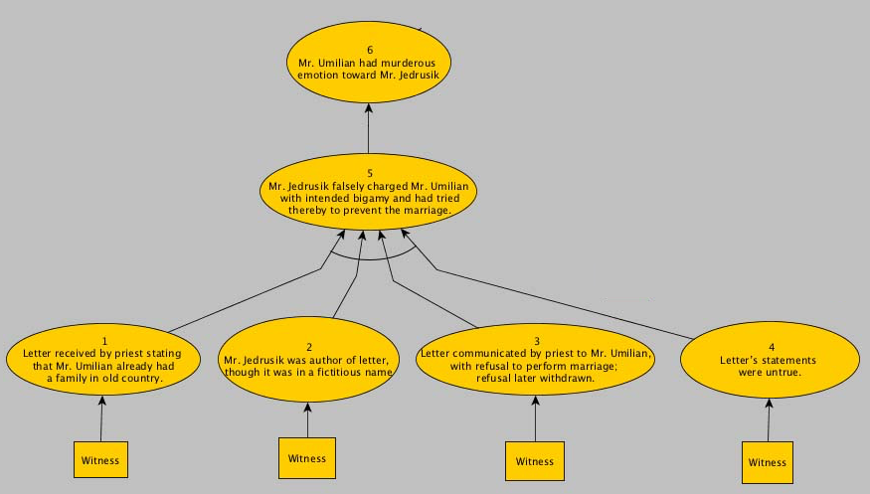
Literature Review
Importance of Graphical Representation
  Network Forensics
  Social Networks
Evidence Representation
  Wigmore’s Chart Method
  Pollock’s Argumentation Scheme

Slide 6
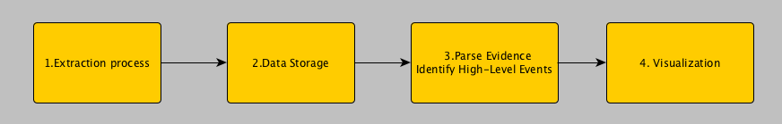
Design & Methodology (1)
Extraction Process
  Timestamps and information from files in the file system
  Information from the Windows Registry
Data Storage
  Store metadata information in .csv
  Parse .csv using Python

Slide 7
Design & Methodology (2)
Rules Set - Three Algorithms created
  “Is the framework able to show what happened in a particular time frame?”
  “Is the framework able to show what happened in a user’s session?”
  “Is the framework able to present information that is related to a file?”
Visualization
  Use of Gephi tool
  Every node contains information like evidence name, id and timestamp
  Able to show clusters created

Slide 8
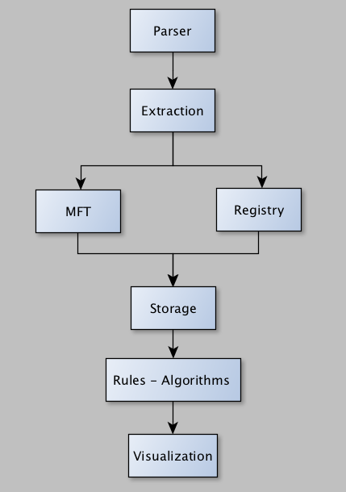
Implementation
Extract file system information using Sleuth Kit Python library (pytsk3)
Extract MFT and use analyzeMFT to extract information to a csv file
Extract Windows Registry information and store it in csv files
  SYSTEM
  SOFTWARE
  SAM
  NTUSER.DAT
Run rules to parse the csv files
  Identify connections between evidence
  Store results in an Array
gdf file implementation for Gephi to simulate

Slide 9
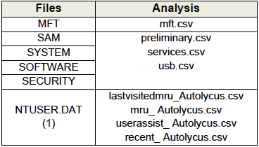
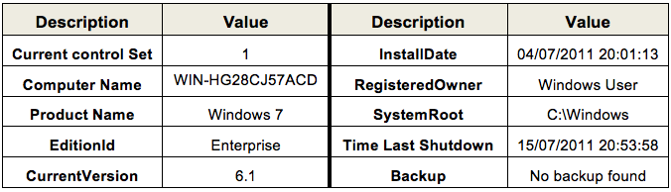

Experiments (1)
Preliminary Investigation
  Able to identify
    Software information
    Device Information
    Time Zone information
    User information

Slide 10
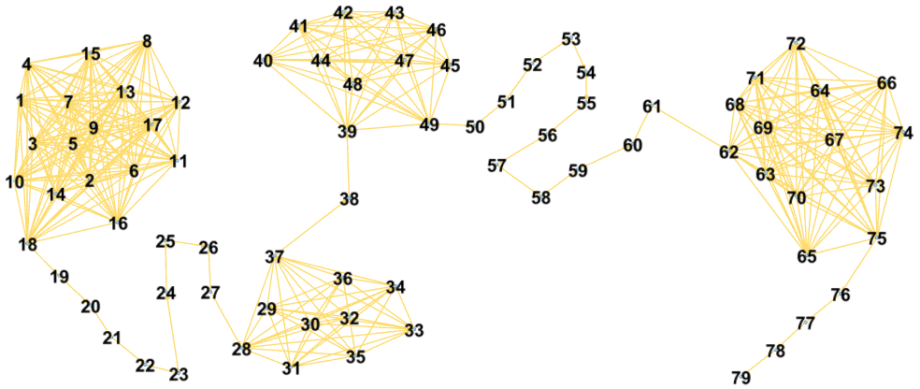
Experiments (2)
Algorithm 2 – User Activity
Four major clusters created
  Allows analysis of large graphs to smaller ones

Slide 11
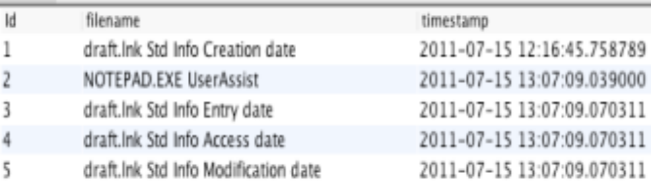
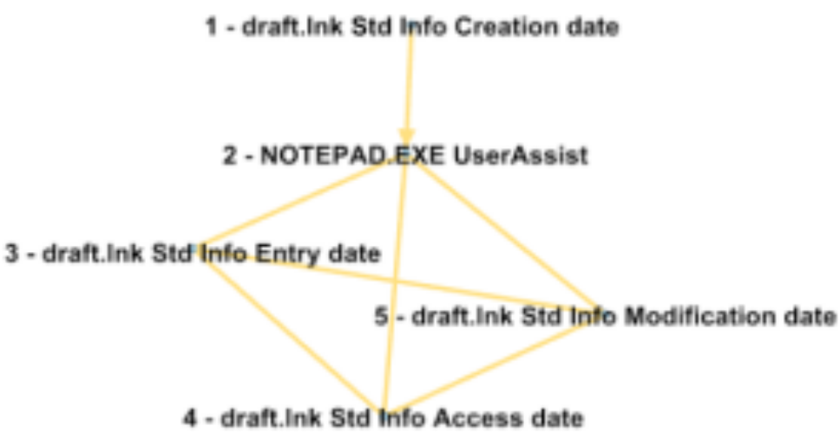
Experiments (3)
Presents information for a file called ‘draft.txt’
  Ability to show file timestamps
  Ability to show program used to open the file
Algorithm 3 – File Investigation

Slide 12
Evaluation
Achieved project objectives
The Framework is capable of assisting in a forensic investigation
  Able to automatically extract evidence from a disk image
  Able to identify connections between evidence
  Able to provide a good visualization technique
An Automated Forensic Analysis tool able to defend against false positives
  Third Algorithm Restrictions
    The program used to create the file the investigator is investigating must be opened up to 300 seconds before the file is created.
    To find a file in the Recycle Bin it must be deleted up to 200 seconds before the file’s timestamp.

Slide 13
Future Work & Conclusion
Import extra functionality to correlate more sources of information
  Internet Evidence
  Hiberfil.sys
  Windows Event Log
  Data Carving Techniques
Conclusion
  Results show ability to assist in investigations
  The framework was tested using specific experiments and identified connections between artifacts correctly
  Further improvements can result
    In a framework able to correlate evidence from a lot of sources of information
    Reduce false positives

Slide 14
References
S. L. Garfinkel, “Digital forensics research: The next 10 years.” Digital Investigation, vol. 7, 2010.
C. Hargreaves, J. Patterson, “An automated timeline reconstruction approach for digital forensic investigations”, Digit Investing, 9 (2012) 69-79.
Y. Chabot, A. Bertaux, C. Nicolle, and M.-T. Kechadi, “A complete formalized knowledge representation model for advanced digital forensics timeline analysis,” Digital Investigation, vol. 11, 2014.
T. Anderson and W. Twining, Analysis of evidence. Northwestern.
“The Sleuth Kit: The Sleuth Kit (TSK) Library User's Guide and API Reference,” The Sleuth Kit: The Sleuth Kit (TSK) Library User's Guide and API Reference. [Online]. Available: http://www.sleuthkit.org/sleuthkit/docs/api-docs/4.3/index.html. [Accessed: Jul-2016].
“analyzeMFT Python Library,” GitHub. [Online]. Available: https://github.com/dkovar/analyzemft. [Accessed: Jul-2016].
“The Open Graph Visualization Platform,” Gephi. [Online]. Available: https://gephi.org/. [Accessed: Jun-2016].
Oh, Junghoon, Seungbong Lee, and Sangjin Lee. "Advanced evidence collection and analysis of web browser activity." digital investigation 8 (2011): S62-S70.
“Data Carving Concepts,” SANS. [Online]. Available: https://www.sans.org/reading-room/whitepapers/forensics/data-carving-concepts-32969. [Accessed: Aug-2016].

Slide 15
Questions?
Thank You

